Slide 1
Holmusk Technical
Challenge
ANKIT GUPTA
M. Tech (Computer Science)
Indian Statistical Institute, Kolkata, India

Slide 2
Objective
With the following dataset, the task is to understand the drivers of prices of the flats.
Click Here to access the dataset.
For the flat price prediction by considering the number of rooms
according to the rules of Singapore Housing and Development Board
[HDB].
Used Python Libraries : Numpy, Pandas, Matplotlib, Seaborn,
Geopy, Geopandas, and Shapely.

Slide 3
Installation of Python Libraries
First, Install all the python libraries in the Jupyter Notebook
by using “!pip install Library_Name”. Installation can also be
done with conda instead of pip and instead of jupyter
notebook, it can also be installed through terminal in Linux.
Please check the documentation page of respective python
library.

Slide 4
Reading “.csv” file and storing it in a dataframe
By using Pandas’ readcsv() function, read the “.csv” file from
the appropriate file path and store it in a dataframe which is
“dataset” here.
It has 287200 rows(records) and 10 columns(features).
# print(dataset.shape).
Features are : month , town , flat_type , block , street_name , storey_range , floor_area_sqm , flat_model , lease_commence_date, resale_price.

Slide 5
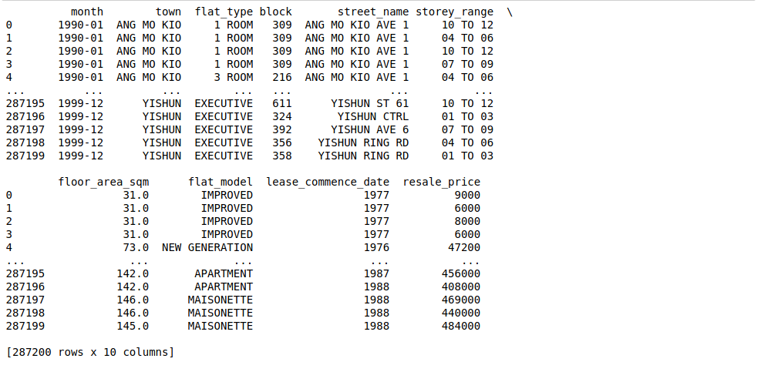

Slide 6
Details about Dataset
By using dataframe.column_name.unique(), we can get the unique values of a particular column. I have used it for “flat_type” and “storey_range” column names.
#dataset.flat_type.unique()
#dataset.flat_type.unique()
To get the statistic about the dataset, we can use dataframe.describe() or dataset.describe().transpose().
#dataset.describe().transpose()

Slide 7
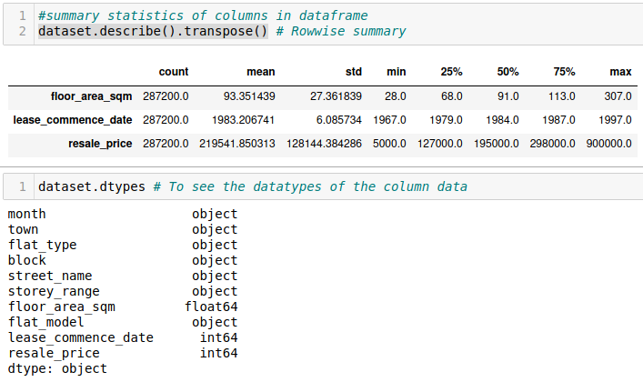

Slide 8
Data Preprocessing
Any machine learning algorithm (whether it is classification or regression) work on numbers. In the given dataset, “flat_type” and “storey_range” columns have both string and numerical data.
So convert it into numerical data.
Based on the rules given by HDB, I have considered 3 bedrooms for “EXECUTIVE” flat_type and 4 bedrooms for “MULTI GENERATION” flat type.

Slide 9
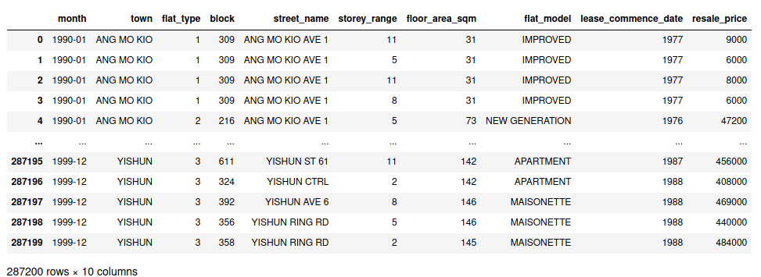

Slide 10
Exploratory Data Analysis
Based on the histograms of “flat_type” and “storey_range” and “flat_models” columns, we can say:
1 ) 3 and 4 bedroom houses are most commonly sold. So, for a builder having this data , it can make a new flat with more 3 and 4 bedrooms to attract more buyers.
2 ) 4 to 6, 7 to 9 , 1 to 3 and 10 to 12 storey_range flats have more count. So, to predict resale flat prices of the flat, we should have to consider these storey range flats.

Slide 11
3 ) "NEW GENERATION", "IMPROVED" and "MODEL A" flat models have more count compared to other flat models. So, while predicting flat prices, we should have to concentrate these flat models.

Slide 12
4 ) flats which have resale prices are between 100000$ and 200000$ have highest count which is 80000 and then comes those flats which have resale prices 200000$ and 300000$ with 70000 count and then flats with resale prices between 0 and 100000$ comes with count ~50000.

Slide 13
Based on the pairplots between various features, we observe the following key points:
1 ) As we can see, there is a spike in the scatter plot between floor_area_sqm and lease commence_date. For lease_commence year between 1960 and 1980, for 2-ROOM flat model, floor area is very high and this 2-ROOM flat model is used between these years only.

Slide 14
2 ) Similarly, APARTMENT,MODEL A-MAISONETTE and MAISONETTE flat models were used between 1980 and 2000 lease_commence year. For "MODEL A" AND "STANDARD" flat models, flat area is under 150 square meters.
3) There is approximate a linear relationship between resale_price and floor_area_sqm MODEL A and STANDARD flat models have floor_area between 100 and 200 sqm for which resale price is between 200000 and 700000.

Slide 15
4 ) PREMIUM APARTMENT have floor_area between 0 and 150 sqm for which resale_prices are under 600000$. For "most" 2-ROOM and TERRACE flat models, lease_commence year is between 1980 and 1998 and resale_prices are above 400000$.
5 ) There is a spike for "3-ROOM" flat_type for earlier lease_commence_year of 1980 which shows total flat area in sqm is maximum in that year for "3-ROOM" flat type floor area for "4 ROOM" and "5 ROOM" flat_type is less than 150 sqm floor area for "1 ROOM" and "2 ROOM" flat_type is less than 50 sqm.

Slide 16
For the given dataset, resale_price and floor_area_sqm are highly correlated.
Correlation is a statistical measure to explain the relationship between two or more than two variables which are used to predict the values of target variable.
If two variables or features are positively correlated with each other, it means when the value of one variable increases then the value of the other variable(s) also increases.
Box-plots (another way of visualizing and analysing data with min,max,25,50 and 75 percentile values)

Slide 17
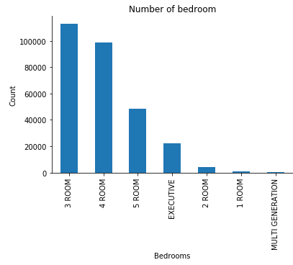
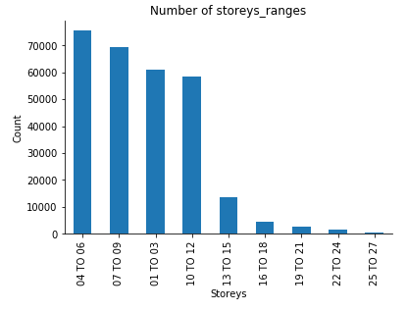

Slide 18
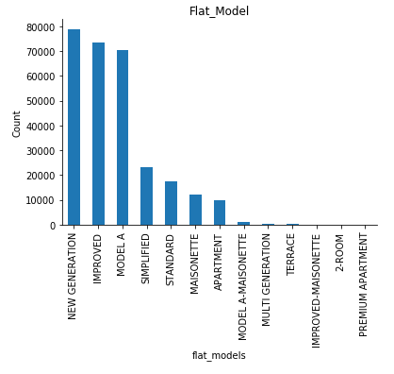

Slide 19
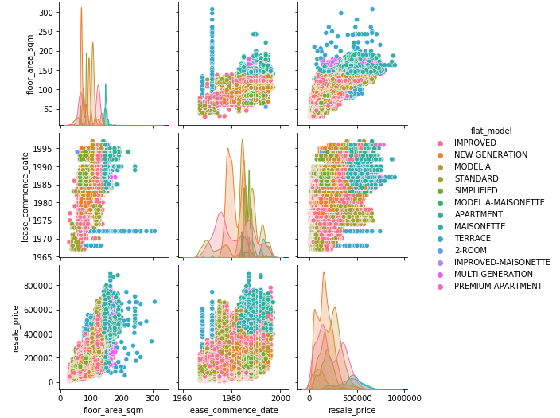

Slide 20
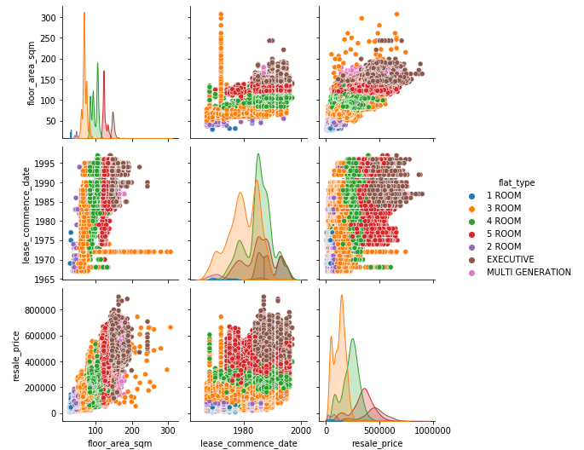

Slide 21
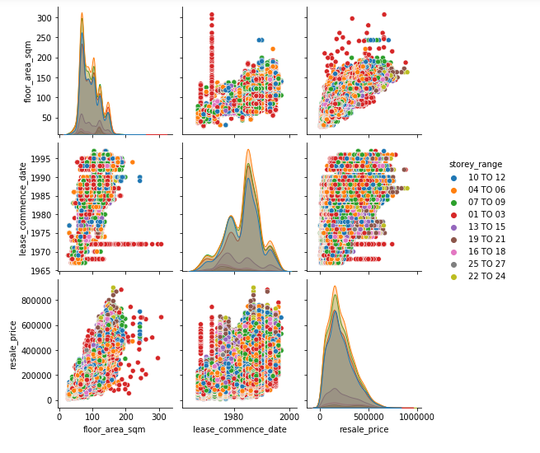

Slide 22
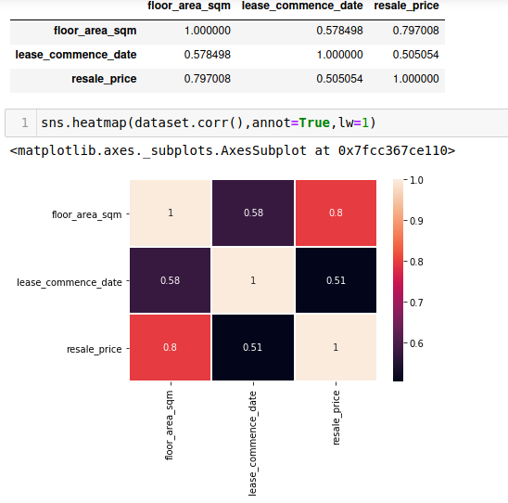

Slide 23
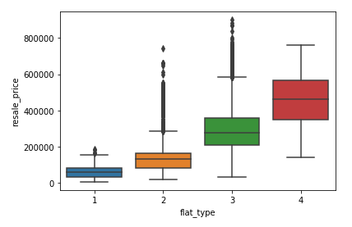

Slide 24
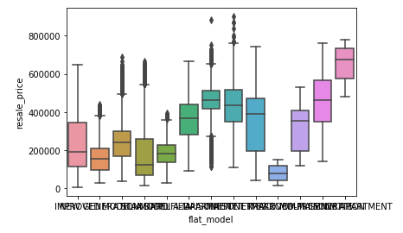

Slide 25
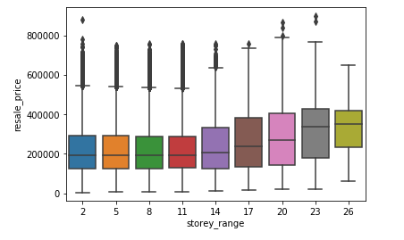

Slide 26
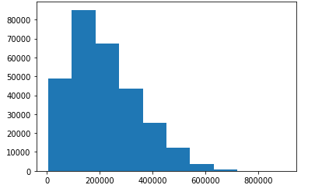

Slide 27
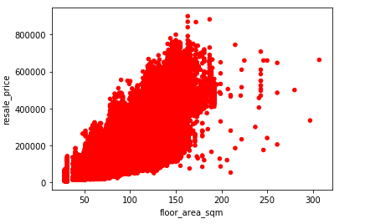

Slide 28
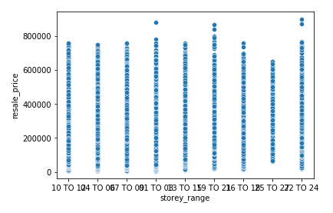

Slide 29
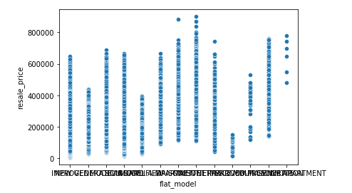

Slide 30
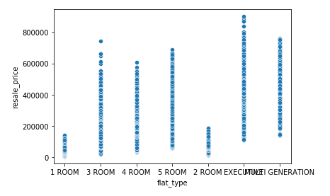

Slide 31
On Adding latitude and longitude columns based on the address given in dataset
As the record size is 287200 in the given dataset and there is a problem of time out if we use geopy library to convert given address into latitude and longitude. So, just to analyze the data, I have considered less record size with 1000 rows.
I have made a single address column by concatenating 3 separate addresses as :
#dataset["address"] = dataset["town"] + " " + dataset["block"] + " " + dataset["street_name"]

Slide 32
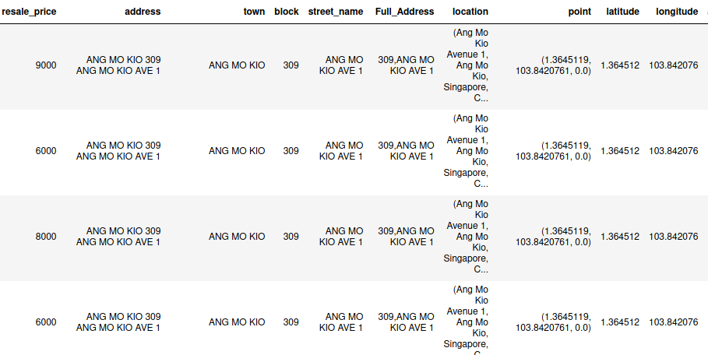

Slide 33
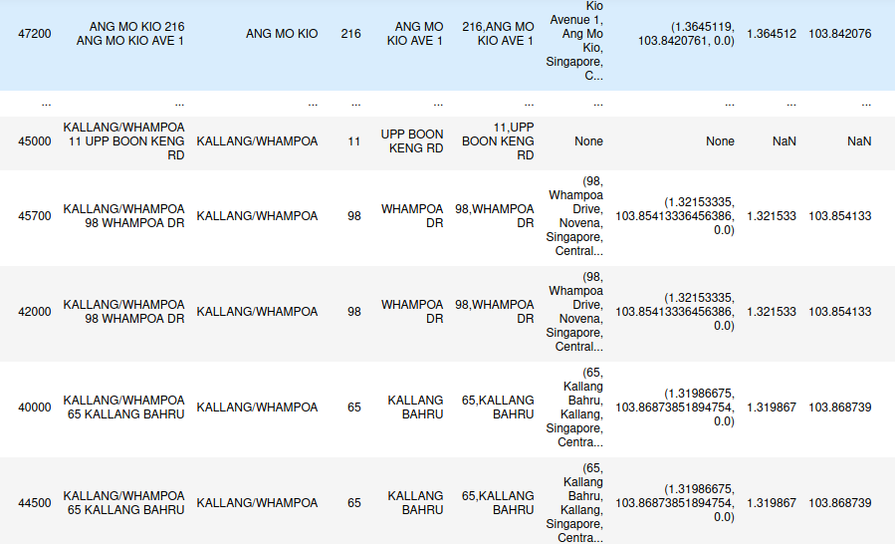

Slide 34
I have removed the Removing the undefined values in the form of 'NaN' :
# new_dataset=modified_dataset.dropna()

Slide 35
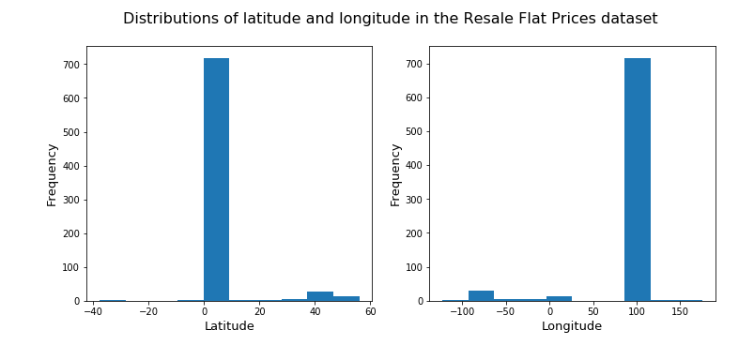
Now, We are going to see the common locations where the flats are placed.

Slide 36
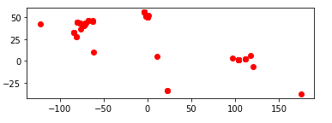
With latitude range 0 to 10, maximum flats were sold and same for longitude around 100. So, these locations might be ideal location for flat sale in future also.

Slide 37
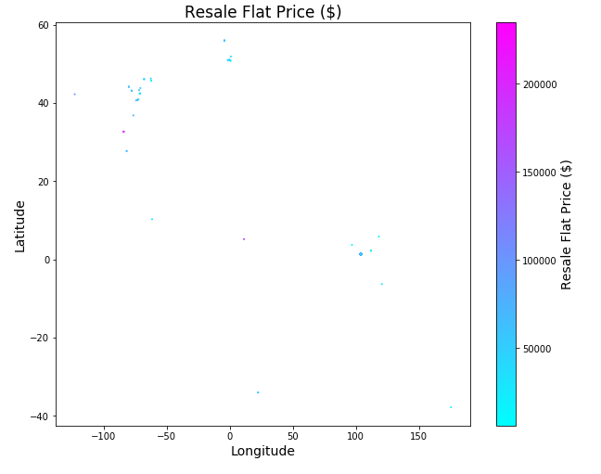

Slide 38
As we can see Locations for which longitude is between -100 to 50 and latitude between 30 to 50, Flat prices are below 5000$.

Slide 39
Building the Model: Predicting the resale flat price
Once we get a good fit, we will use this model to predict the sale price of the flat.
I have used the Linear Regression model here to get the best fit hyperplane for the given datapoints.
Equation of Best Fit Hyperplane: z* = (A^{T}A)⁻¹ A^{T}b for system of equations Az=b.
where , vector b is not in plane of column vectors of matrix A and to get the approximate solution, we have to project the vector ‘b’ in the plane which is ᵬ and so solving Az* = ᵬ, we get, z* = (A^{T}A)⁻¹A^{T}b.

Slide 40
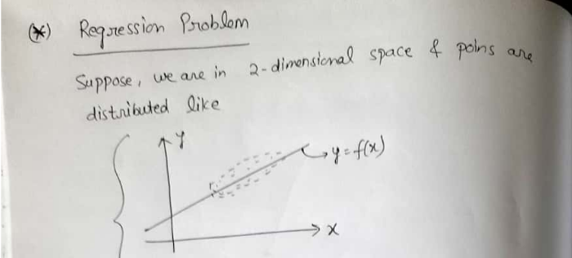
Maths behind Linear Regression

Slide 41
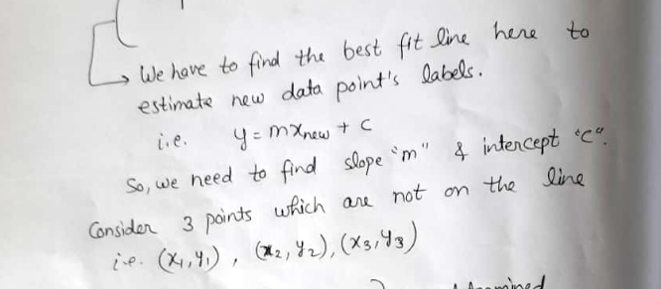

Slide 42


Slide 43


Slide 44


Slide 45


Slide 46


Slide 47
Thank You !

